Slide 1
HEALTHY PACKED LUNCHES

Slide 2
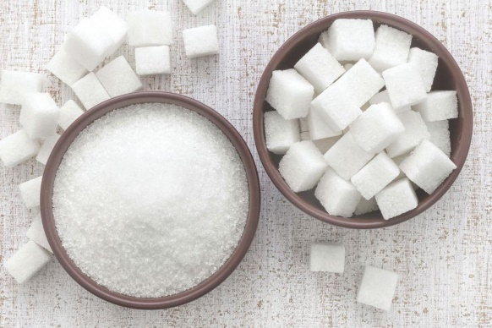
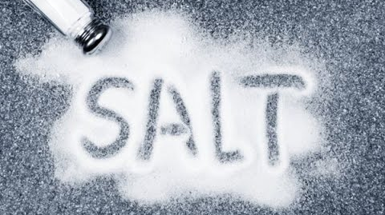
We are changing our packed lunches
Too much sugar leads to…
Tooth decay
Mood swings
Tiredness
Hunger cravings
Can lead to weight gain
Too much salt leads to …
Problems with blood pressure (in later life)
Food cravings
Dehydration (not enough liquid)
Hunger cravings

Slide 3
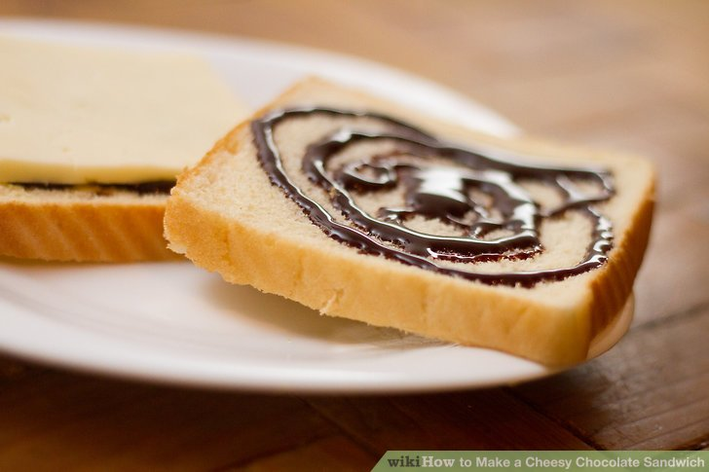
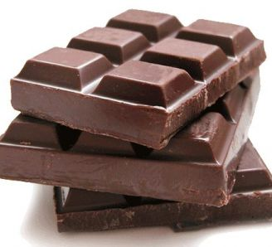
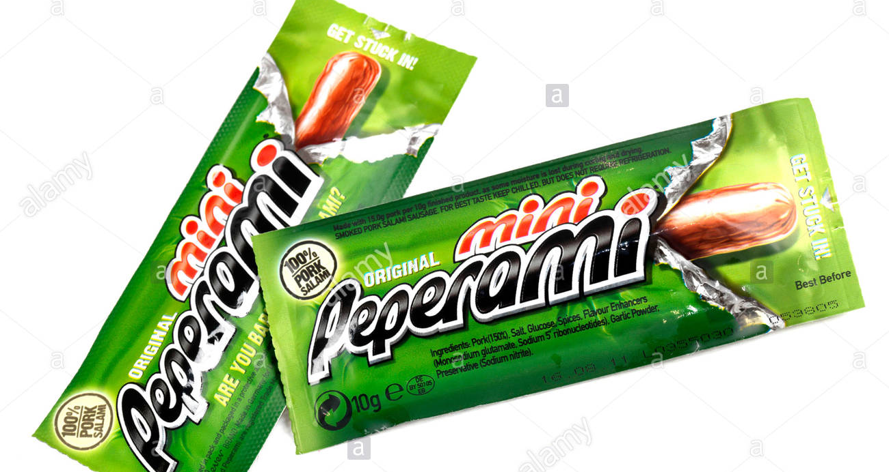
What’s wrong with these foods

Slide 4
What’s wrong with these foods
Sugar!
salt!
Sugar!

Slide 5
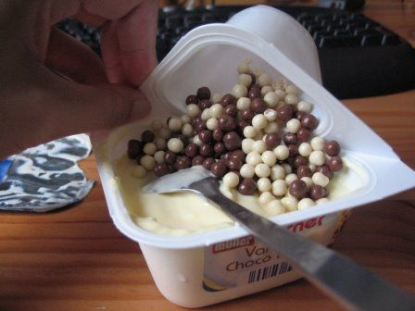
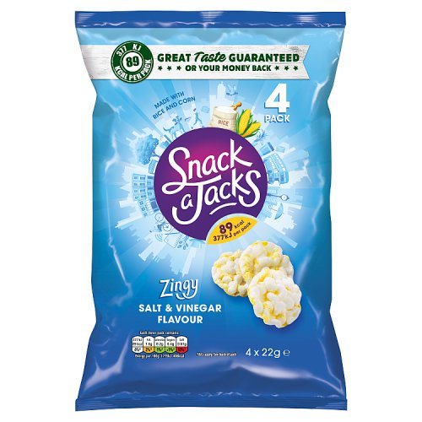
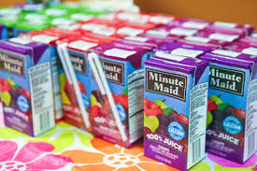
A bit trickier but what’s wrong with these?

Slide 6
A bit trickier but what’s wrong with these?
The yoghurt is healthy but the chocolate/sweets are not.
These are better than crisps but still contain too much salt
Juice like this contains too much sugar because of the way its made

Slide 7
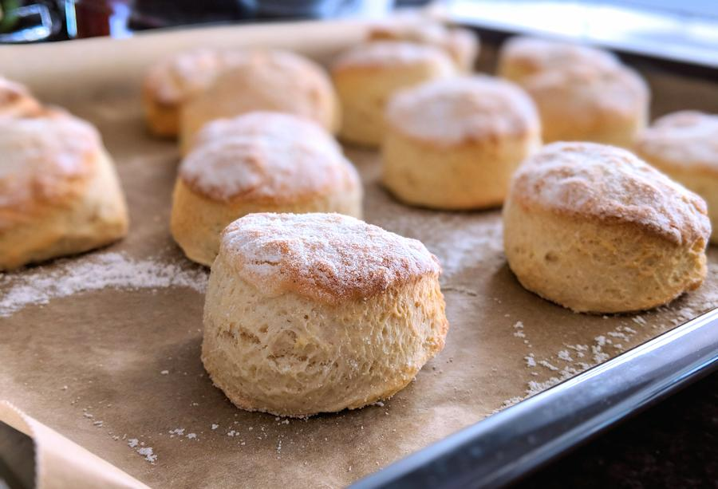
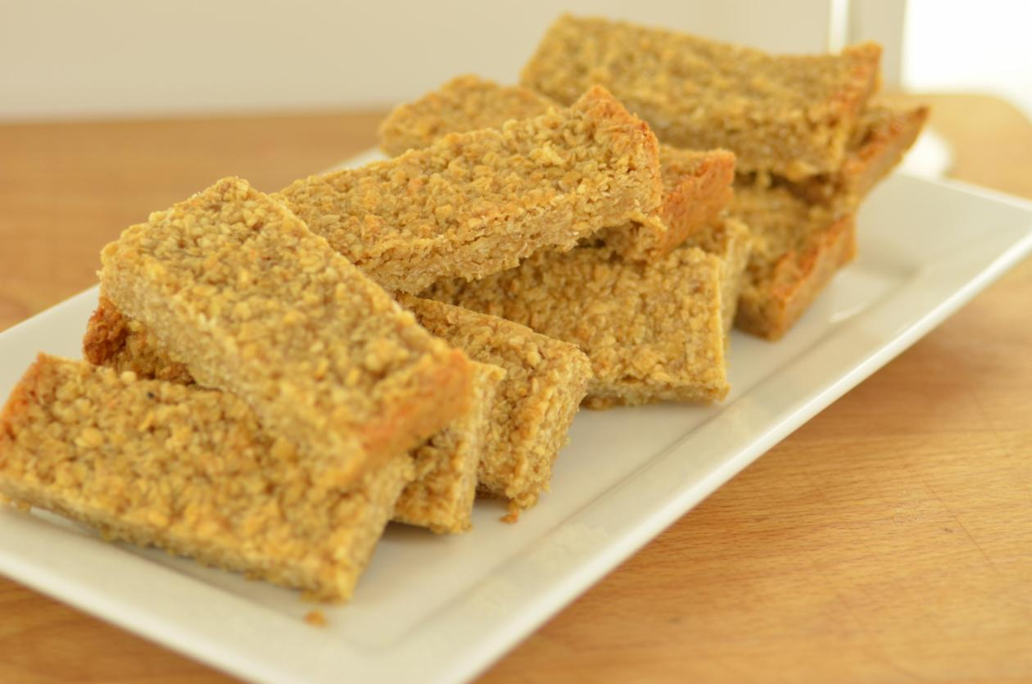
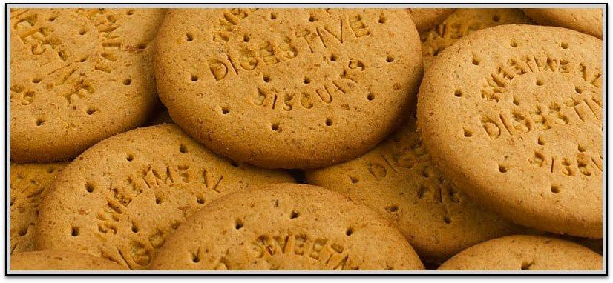
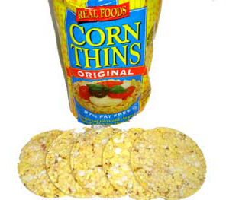
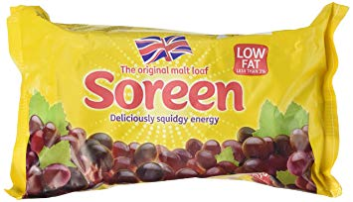
How about these?

Slide 8
How about these?
Less sugar
Less sugar
Less salt

Slide 9
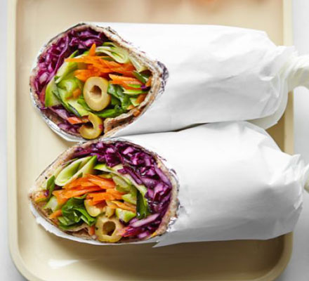
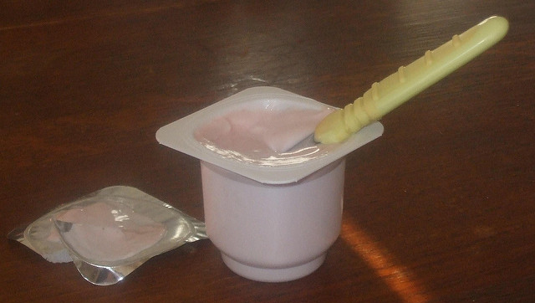
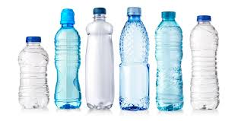
We want all our children to know that …
We all need a balanced diet to be healthy
Food that is high in salt and sugar should be eaten occasionally (in moderation)
Other food may contain some sugar or a little salt and could be eaten more often
Healthy foods (fruit, vegetables, dairy, pasta, bread, rice, legumes (such as lentils or chickpeas) can be eaten every day
Water is the best drink to keep you hydrated throughout the day (and can be flavoured with sugar-free squash or sugar-free fruit flavouring)
Don’t ban food from your diet

Slide 10
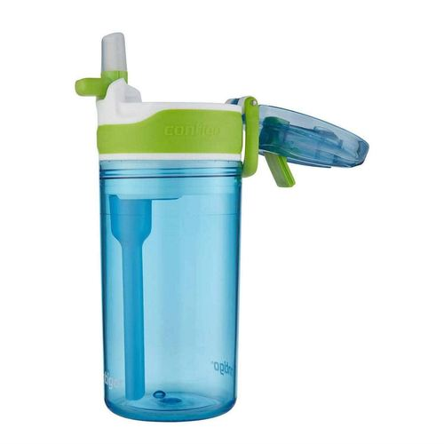
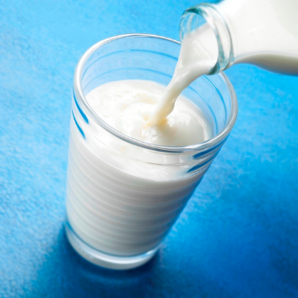
DRINKS….
No to fizzy and sugary drinks (including juice)
Water (including sugar free squash or flavoured water) or milk

Slide 11
Every day!
3x a week
Friday!

Slide 12
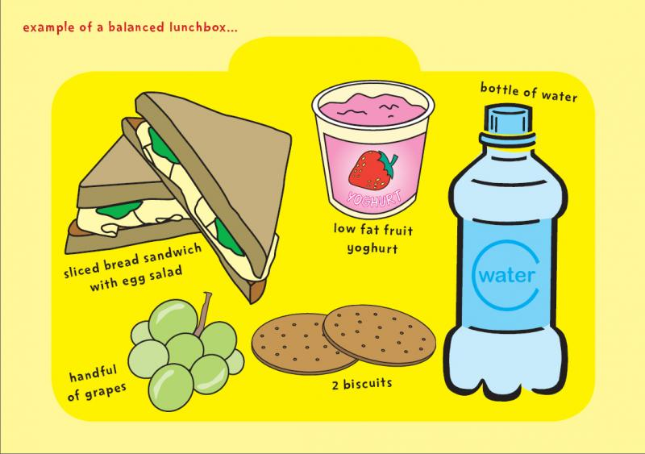

Slide 13
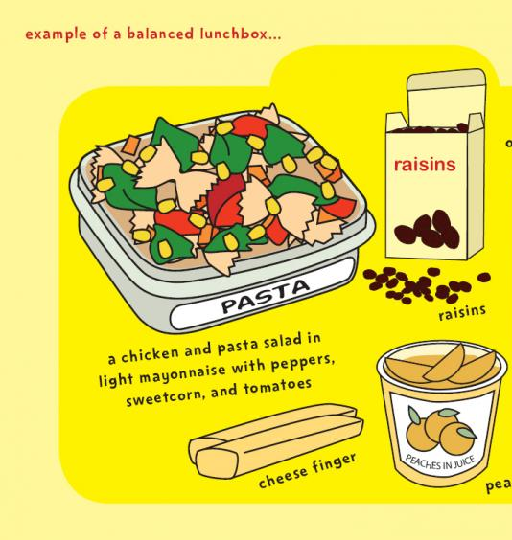

Slide 14
Our new packed lunch system starts next week!
For the next 2 weeks if you bring a red food in on the wrong days we will remind you of what you should do.
If you have too much amber food we will also remind you of what you should do.
After that we will remove the food and you can take it home at the end of the day.

Slide 15
Good to me…
Friday 14th celebrate what makes you proud by wearing it!
It could be:
National Dress
Uniform such as scouts or guides
Other uniform such as football kit or dance clothes

