Slide 1
Welcome to the Year 3’s
‘Solve Problems with Me!’
Workshop 2024.

Slide 2
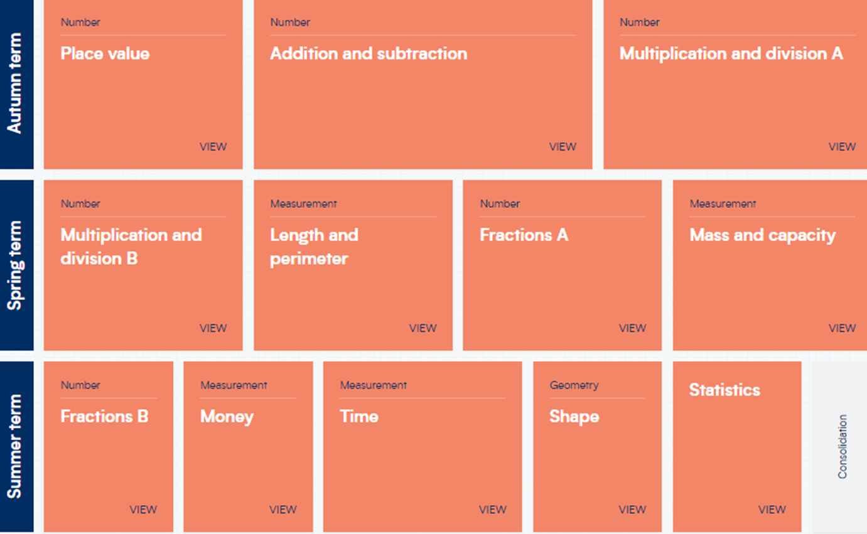
In Year 3, we use the combination of two schemes to develop your child’s Maths Mastery. This is an overview of what the year roughly looks like.

Slide 3
At Firs Farm, we recognise that fluency with times tables underpins mathematical understanding. Knowing your times tables is essential for all children. This will help them more easily grasp a wide variety of other concepts such as division, fractions, and percentages.

Slide 4
Below is an outline of the National Curriculum times tables expectations for each year group:
Year 1 Count in multiples of 2, 5 and 10. Recall and use doubles of all numbers to 10 and corresponding halves.
Year 2 Recall and use multiplication and division facts for the 2, 5 and 10 multiplication tables.
Year 3 Recall and use multiplication and division facts for the 3, 4 and 8 multiplication tables.
Year 4 Recall multiplication and division facts for all multiplication tables up to 12 x 12.
Year 5 Revision of all times tables and division facts up to 12 x 12.
Year 6 Revision of all times tables and division facts up to 12 x 12.

Slide 5
There is a Multiplication Tables Check in Year 4. The MTC aims to determine whether Year 4 pupils can fluently recall their multiplication tables.
Therefore, we would expect your child to know their 12 x 12 times tables before they leave Year 4, with Years 5 and 6 for consolidation and revision.

Slide 6
Importance of Times Tables
Knowing times tables facts is important to your child’s progression in their Mathematics education.
Without a deep understanding of multiplication and division facts, children could get challenged when it comes to fractions and multiplication or division with larger numbers.
Many mental maths activities, and life experience require a quick recall of multiplication and division facts.
Learning multiplication facts and tables are most effective when there is collaboration with the school, parents and children. In school, we spend time learning times tables, but a child will be more successful of the practise outside of school independently and alongside parents.

Slide 7
In every lesson we recall the key vocabulary:
Key vocabulary:
groups of times by multiplies by lots of
times table product multiply times
commutative repeated addition

Slide 8
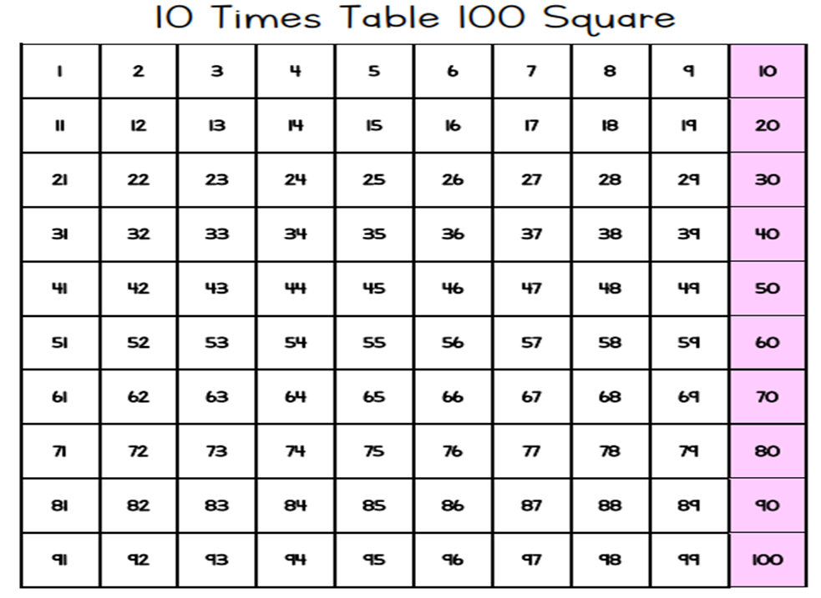
We have been using a 100 square to look at the 2, 3, 4, 5 and 10 times tables.
Shade them on the hundred square!
©Deepening Understanding LTD 2019

Slide 9
We use arrays to represent the times table:
6
$$×$$
3
$$=$$
18
3
$$×$$
6
$$=$$
18
18
$$÷$$
3
$$=$$
6
18
$$÷$$
6
$$=$$
3

Slide 10
We show our times tables by grouping.
What do you see?
3
4
There are ___ equal groups with ___ in each group.
$+ + =$
4
4
4
12
3
4
12
$× =$
3
4
12
___ $×$ ___ $=$ ___
$× =$
4
3
12
12
There are ___ altogether.

Slide 11
The children also need to understand times tables as repeated addition.
4
4
4
4
$+ + + +$
8
4
There are ___ equal groups with ___ in each group.
$+ + + =$
4
4
4
4
32
8
4
32
___ $×$ ___ $=$ ___
$× =$
8
4
32
32
There are ___ altogether.
$× =$
4
8
32

Slide 12
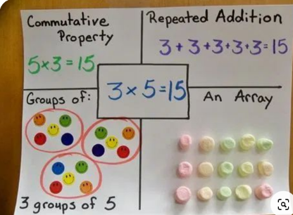
This is a multiplication strategies poster.
These posters are an excellent way of understanding the multiplication facts and the strategies we could use to help us.

Slide 13
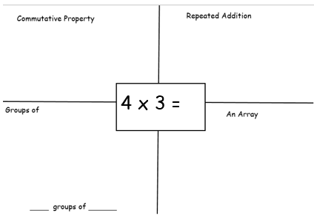
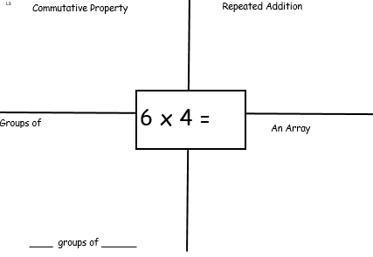
We are going to create our own multiplication strategies poster.

Slide 14
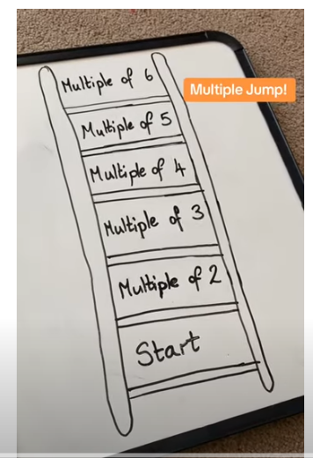
https://www.youtube.com/watch?v=DZKBc3W6Y1k

Slide 15
Where can I look for support?
My Maths
Topmarks Games – Hit the Button
BBC bitesize for specific skills explained in a child friendly
way - https://www.bbc.co.uk/bitesize/primary
TTRS – Times Table Rock Stars

