Slide 1
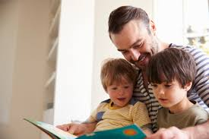
Welcome to our Book Week Reading Café!
Read With Me.

Slide 2
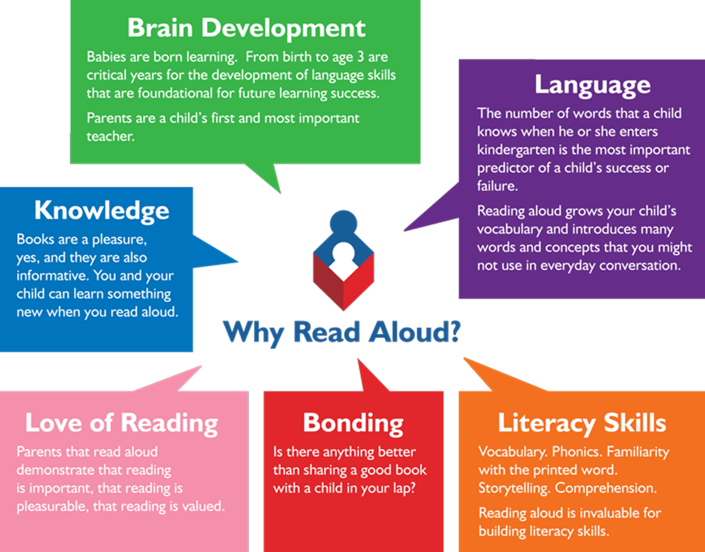
Reading at an early age and securing phonics.
Reading from an early age is important as research shows that if children are not secure and fluent readers by Year 2, it is very difficult to then develop a love of reading going forward.
In order to get children fluent in reading, their phonic knowledge must be embedded within EYFS and KS1.
Read to children from day zero!

Slide 3
Supporting your child with their reading KS2.
Please write on a post-it note any specific difficulties you have when reading with your child.

Slide 4
Reading at school.
Guided Reading
Based on VIPERS skills: vocabulary , inference , prediction , explanation , retrieve and Summary
Whole class reading with a focus on oracy
Shared Reading
During literacy lessons, whole class text
Independent Reading
Supported by teachers and TA’s
School Library

Slide 5
What can and should your children read?
Access to high quality texts across the school
Book corners
Library visits
Children can visit the library with their class once a half term. They can take out books and recommend authors and books to each other.

Slide 6
What can and should your children read?
We want all children to experience success.
We aim to introduce them to a variety of text types and authors through both our reading and our literacy sessions.
Please use your parental judgement to ensure the support/challenge at home is at the right level.
Use all reading materials, including newspapers, instruction leaflets, eBooks, and magazines. Your local libraries can also be a good source of reading materials.

Slide 7
Reading at home with your child
Expectations: ideally 20 minutes per day
Try to build this into your daily routine
Have a quiet and comfortable space where your child (and you) can read.
Read with your child and read in front of your child.
Remember, both reading and hearing texts read aloud are important.

Slide 8
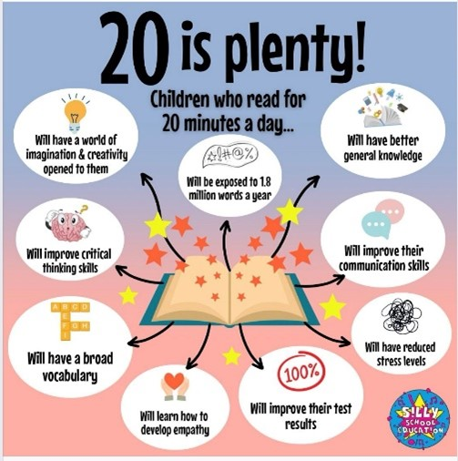
Why 20 minutes?

Slide 9
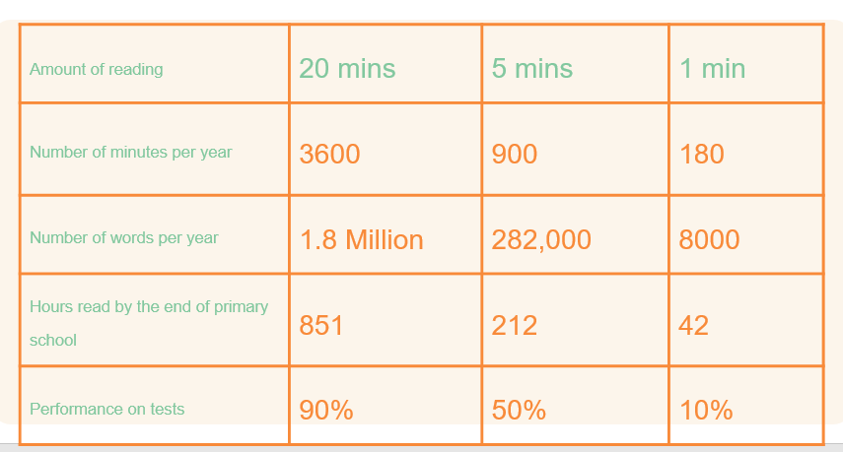
Why 20 minutes?

Slide 10
Before Reading
If this is the first time your child has read the book, look at the cover and title with them and predict what they think the book might be about.
Make links to other books read with similar themes, the same characters and/or similar authors/illustrators.
Give them time to flick through the book
and read the blurb.

Slide 11
During Reading
Encourage children to track the words with their fingers or use a ruler.
Help children to decode (read) the words and ask them about the meaning of more challenging words.
Ask children about the content of what they’ve read – who, what, when, where, why and how?
Predict what might happen next :
Do you think Elena is likely to go swimming today?
Will Elena listen to her grandmother in the future?
Why? How do you know

Slide 12
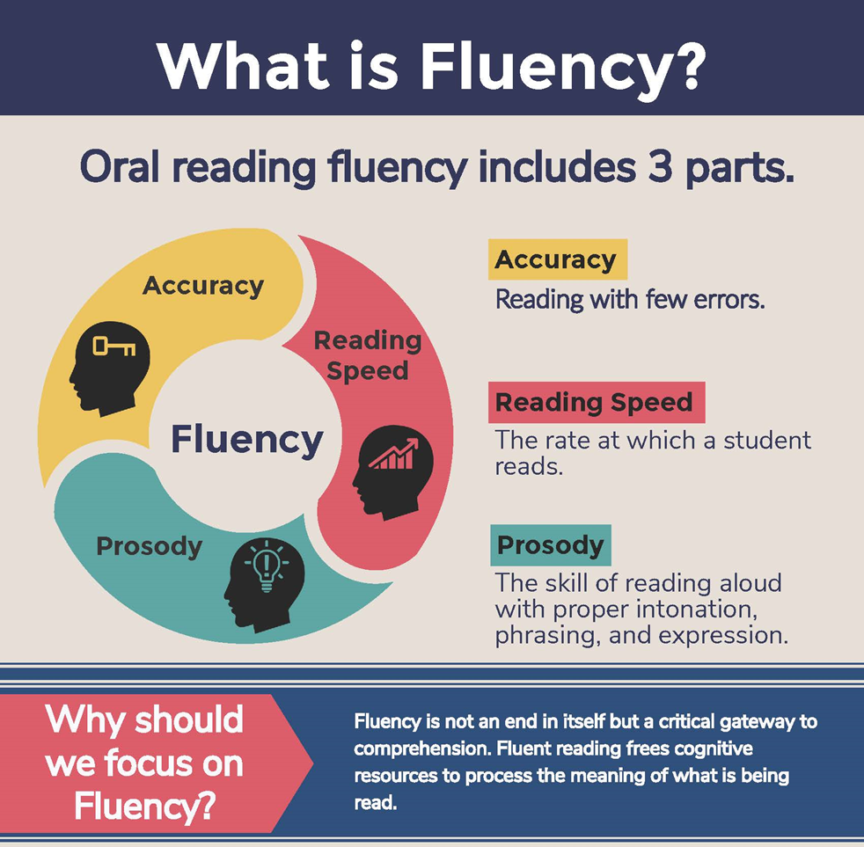
Fluency during Reading
Fluent reading supports reading comprehension. When pupils read fluently, their cognitive resources can be redirected from focusing on decoding to comprehending the text. For this reason, fluency is sometimes described as a bridge from word recognition to comprehension.
Basically, if the brain’s processing power isn’t being used up by working out how to read a word, it can concentrate on understanding and enjoying the text.

Slide 13
Fluency during Reading
Read and follow – the adult reads the text and the child follows along with their finger. This helps the child with word recognition and models to them how they should read with fluency.
My turn, your turn – take turns reading a page or a paragraph. Here you are modelling how to read with fluency, flow and expression.
Echo Reading – as you read, the child copies. It is important here to pace yourself and read at a rate that your child can keep up with.
Let’s have a go!

Slide 14
Reading skills linked to VIPERS
Vocabulary -
Interpreting words in context and deciphering the meaning of words unknown based on the context they are written.
Mr. Ali loathes wearing a tie as he finds it uncomfortable.
We may not know the meaning of the word ‘loathe’ here but based on the context and other evidence within the sentence, we can guess it means ‘doesn’t like’. How have I arrived at this conclusion?
Beowulf was incensed by Grendel’s attack and vowed revenge.
We may not know the meaning of the word ‘incensed’ here but we can guess it means ‘angered’. How have I arrived at this conclusion?

Slide 15
Reading skills linked to VIPERS
Inference: is an interpretation that goes beyond the literal information given and relies on the evidence within the text as well as background knowledge.
The police find a threatening letter addressed to the victim.
We could infer that someone didn’t like that person.
The bike lay on the floor next to her as she held her leg and cried.
We could infer that the girl fell off her bike.
My stomach rumbled as the smell of dinner wafted from the kitchen.
We could infer that this person is hungry.

Slide 16
Reading skills linked to VIPERS
Predict – what has or what will happen based on information stated or inferred (linked closely to inference). Again, background knowledge here is important.
Beowulf snatched his sword from the armoury and ran towards the mountains.
What do predict Beowulf is going to do? What evidence have you used to make your prediction?
Mr Ali woke up with a terrible headache and severe cough. He picked up his mobile and began to dial.
Who do you think Mr Ali is going to call? Why?
Predictions, like inferences, are neither right or wrong. They may be strong (with secure evidence to back them up) or weak (with little or poor evidence to back them up).

Slide 17
Reading skills linked to VIPERS
Explain –
Identify/explain how information/narrative content is related and contributes to the meaning as a whole.
Identify/explain how meaning is enhanced through the choice of words and phrases.
Make comparisons within the text.

Slide 18
Reading skills linked to VIPERS
Retrieve
Retrieval of information is often the starting point for discussing a text. This means picking the exact (spelling and punctuation too) information out of the text that they have just read. E.g.
What was the character’s name?
What did they eat for dinner?
What colour was the car?
What time did…
Summary -
Summarise main ideas from more than one paragraph
What is the main point of the first paragraph?
What heading would be appropriate for this paragraph?

Slide 19
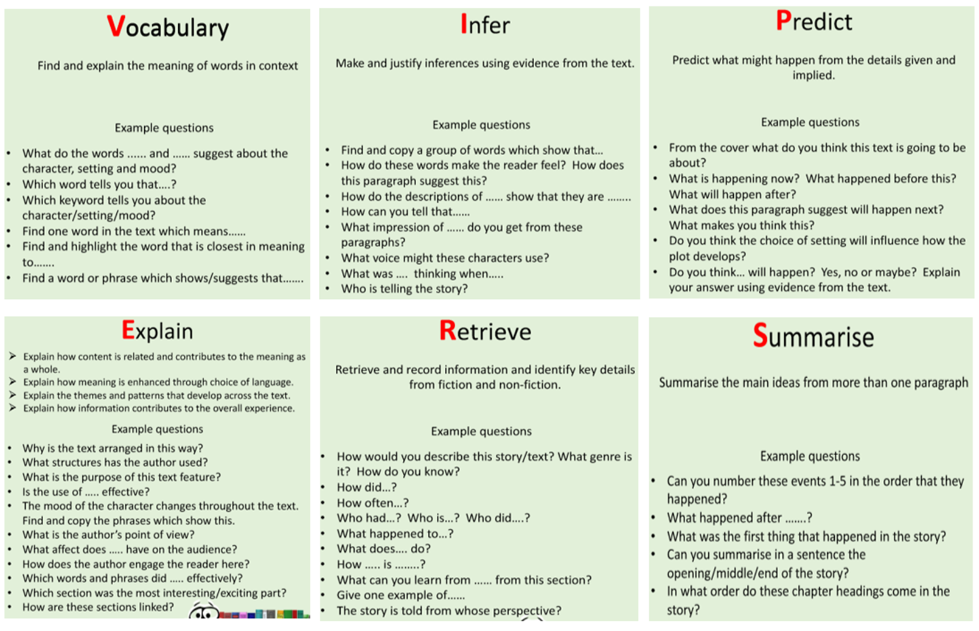
Questions you could ask at home

Slide 20
Good websites
Kate Greenaway Medal and Carnegie Medal
https://www.goodreads.com/list/show/101454.Kate_Greenaway_Award_Winners
Book Trust – amazing website, book lists under categories, e.g. authors from different cultures, graphic novels, books about themes , books featuring characters with disabilities, books for children with autism.
https://www.booktrust.org.uk/books-and-reading/our-recommendations/
Best Book guide
https://www.booktrust.org.uk/books-and-reading/our-recommendations/100-best-books/

Slide 21
Remember
Encourage a love of reading – use libraries, audiobooks, Newsround website, National Geographic Kids, and First News.
Encourage children to read…anything(!) and, ideally, a range of genres and authors.
Read higher level texts aloud to children
Enthuse about particular authors.
Use audiobooks.

