Slide 1

Meet The Teacher
Year 5: 5H, 5C, 5N

Slide 2
Welcome to Year 5
Adults that work in each class:
5H: Mrs Hughes/ Madame Dejonghe(Fridays)
5N: Ms Nunez
5C: Mrs Constantinou /Ms Price ( Fridays)
Additional adults: Mrs Henry, Ms John, Ms Stewart

Slide 3

Class Behaviour Systems
In our school we celebrate and promote positive behaviour through our values. We use the UNICEF Rights Respecting Charter to promote this.
Our class system is Class Dojo.
We celebrate good behaviour by plenty of praise.
Our sanctions could include taking Class Dojo away and detentions.
Children can also gain house points and the house with most points is announced each week during the assembly.
Walking to and from in the building – silent/ not making any noise.

Slide 4
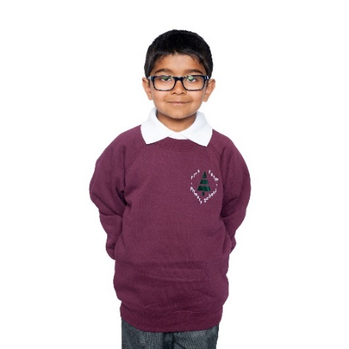
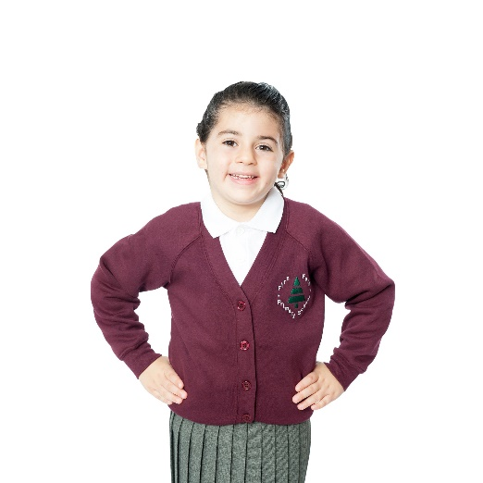
School Uniform
Please remember that our school uniform is:
  Maroon sweatshirt
  Maroon fleece (for outdoor wear only)
  Grey skirt or pinafore
  Grey or black trousers
  Black leggings are allowed underneath skirts/pinafores
  Plain white, black or grey socks or tights
  Black trainers and shoes are allowed to be worn in school.
  Long hair should be tied back at all times
  Children should not wear jewellery except for watches (not smart watches) and small studs in pierced ears.
  Please note that the school does not provide stationery any more. Therefore, please make sure that the children have pencils, rubbers, pritt sticks, rulers and handwriting pens.

Slide 5

PE Days
5H : Tuesday and Thursday
5N: Tuesday and Thursday
5C: Monday and Thursday
On these days children should come into school wearing their PE kit.
  Black shorts (no cycling shorts)
  House T-Shirt
  Dark-coloured jogging bottoms and school jumper/cardigan for colder weather (no hoodies or tracksuit tops).
  Plain black trainers (no brands) - NO plimsolls, please
  For safety reasons, children should have long hair tied back, and should not wear any jewellery during these lessons.

Slide 6
What to expect in Year 5
French trip
Swimming
STEAM Project
Playground rangers
JTA – junior travel ambassadors
Trip
Reading Champions
Digital Leads

Slide 7
English Curriculum
We will be focusing on:
Narratives, descriptive writing, poetry, instructional texts, persuasive writing
Grammar: Revision, expanded noun phrases, synonyms and antonyms, word classes
Spellings: Year 5 and Year 6 statutory spelling list
You can help your child with their reading by ensuring they are reading for 30 minutes daily and recording this in their home-school diaries. We would also like these to be signed by an adult each week.

Slide 8

English Curriculum
This half-term, we will be:
- Focusing on growth mindset and mindfulness to support us with settling into a new school year
- Reading the novel Percy Jackson and the Lightning Thief, linked to our learning on Greece and Persia

Slide 9

Maths Curriculum
This half-term we will be focusing on:
  Place value to six digits.
  Addition, subtraction, multiplication and division
Ways you can help your child with their maths: regular practise of times tables, access to My Maths as well as real-life mathematics (e.g. reading the time, working out change in a shop).

Slide 10
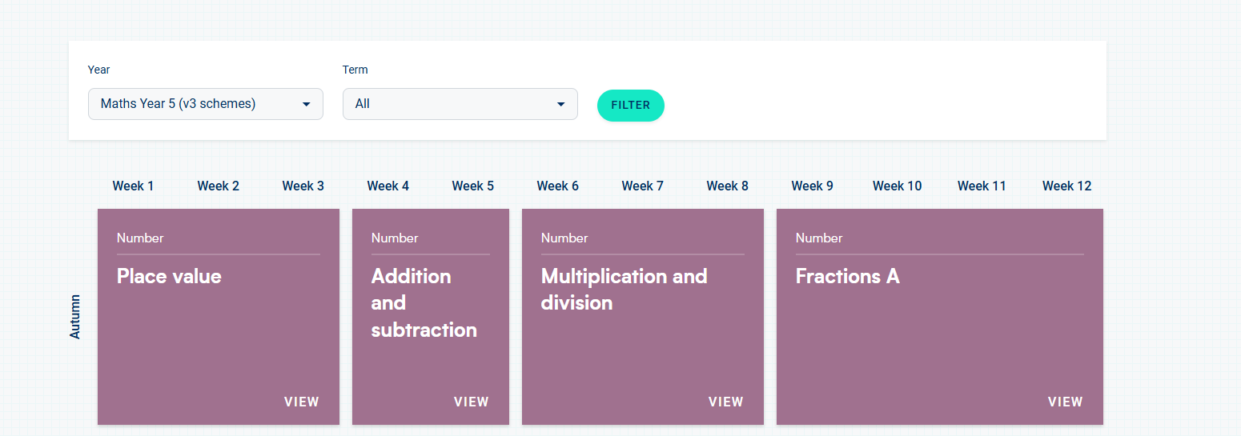
WHITE ROSE MATHS HOME LEARNING SUPPORT
Use the link or use White Rose Home learning videos to support your child at home. Select the year 5 topic we are currently learning to practise and consolidate their learning.
White Rose Education | White Rose Education

Slide 11

Autumn Term
PE will be taught by either own class teachers or PE coach
Computing will focus on Internet safety and Cyberbullying, touch-typing skills, and using Word to develop processing skills.

Slide 12

Homework
English and Maths homework is set on a Friday and due back in on the following Friday.
English will consist of a comprehension task.
Maths homework will be set on My Maths every week.
Spellings are given every Friday and will be tested the following Friday.
All homework will be assigned via Microsoft Teams and should be submitted that way. No paper will be given out/taken in.
If you are unable to access Teams or do not have Internet/device access at home, please ask your child to let their class teacher know or email year5@firsfarm.enfield.sch.uk.

Slide 13
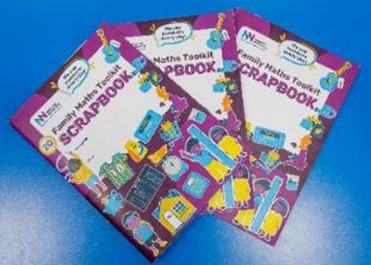
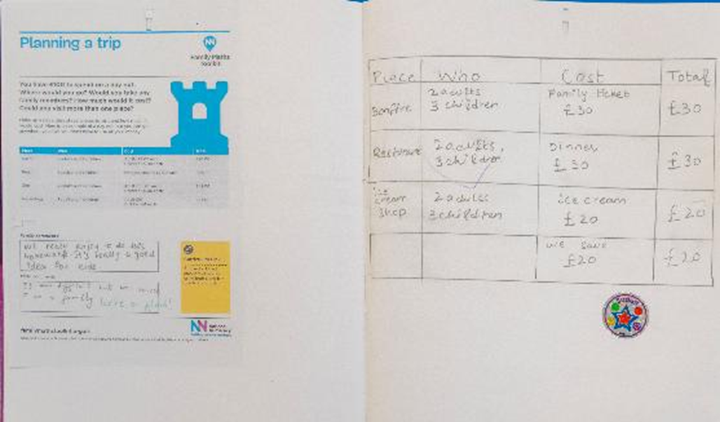
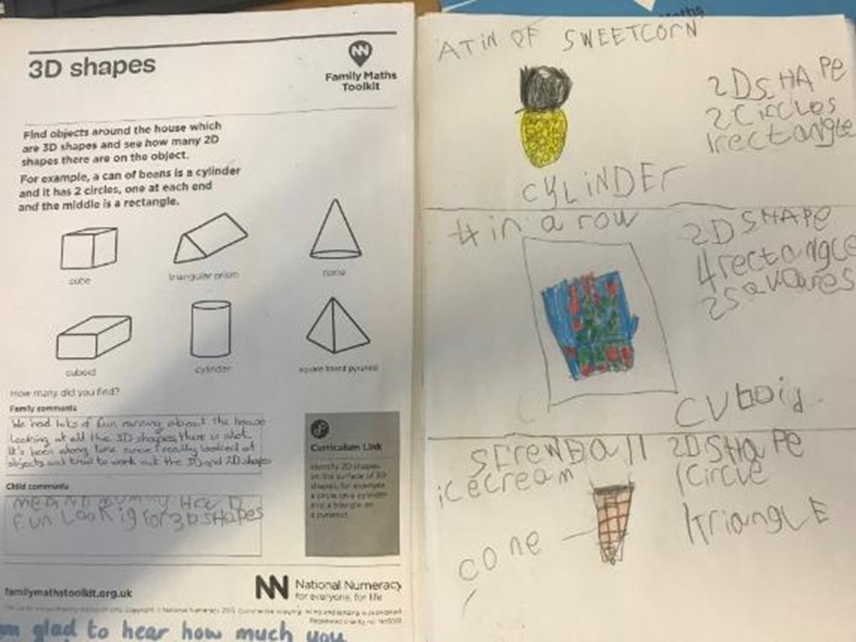
National Numeracy Project: Help Your Child Love Maths!
Aim is to..
1. Increase pupil’s - confidence with numbers - positive feelings about maths - awareness of the value of maths outside the classroom
2. Increase parents and carers confidence in supporting children with maths.
Your child will receive a National Numeracy Scrapbook
-Class teacher will set a home activity every 2 weeks to complete at home with a parent, then return to school to be shared and celebrated.
-Activities are linked to their age group and National Curriculum objectives
-Celebrate in school – Certificates, class display, rewards

Slide 14

Attendance

Slide 15
Impact lost days have...
Above 95% attendance - 70% of children reached the expected standard or better in Reading Writing and Maths combined in SATs.
Below 95% attendance - only 50% of children reached this level.
Below 92% attendance - only 35% of children reached this level.

Slide 16

Who can help if I have a problem?
In the first instance please email your child’s class teacher at year5@firsfarm.enfield.sch.uk and they will respond as soon as they can.
If your enquiry/message is urgent (e.g. regarding pick up), please phone the office who will then pass on a message.
If you need further help please contact our phase leader by making an appointment through the school office:
  Y5 & Y6 Mrs Xenophontos (6X)
If you need help after this please contact our Headship team by coming to the school and possibly making an appointment if not available:
  Mrs West ( Assistant Headteacher)
  Mr Biss ( Deputy Headteacher) Year 3, 4, 5, 6
  Mrs Husband (Headteacher)
If it is a matter that concerns safeguarding/child welfare or is very urgent please speak to a member of the headship team immediately.

Slide 17
If you have any questions, please email us at year5@firsfarm.enfield.sch.uk

