Slide 1

Tuesday 7th October
Year 3 Reading Cafe

Slide 2

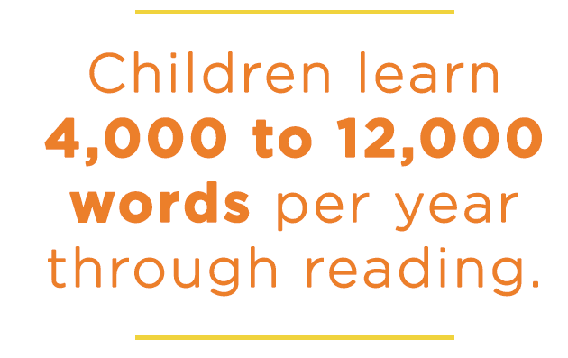
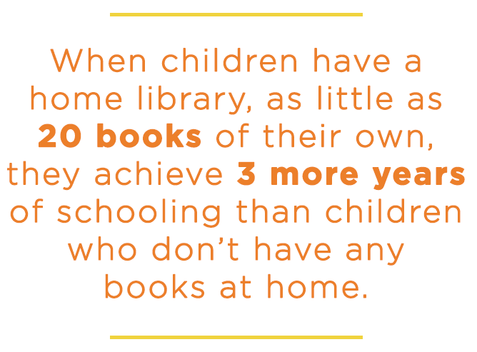
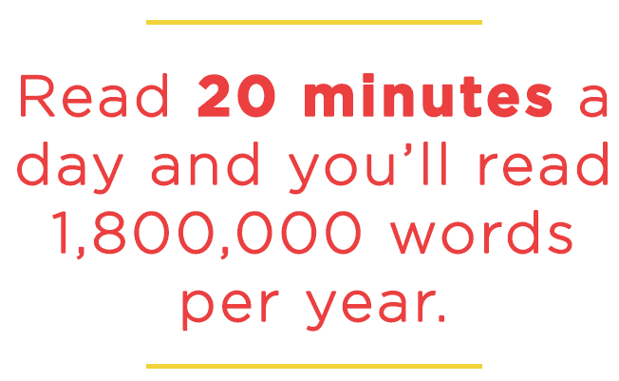

Slide 3
Today, we will show you a shortened version of our reading session, which we deliver three times a week. Most children in Year 3 complete this unless they are still on their Little Wandle journey. If this is the case, they participate in a phonics session three times a week.

Slide 4
The Magic Faraway Tree
Enid Blyton
Up to the end of Page 3
https://www.lovereading4kids.co.uk/book/4863/The-Magic-Faraway-Tree-Enchanted-Wood-by-Enid-Blyton.html

Slide 5
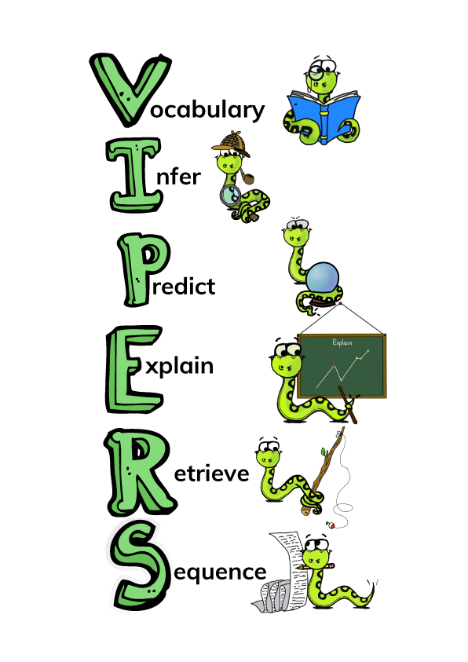
All of our reading links back to the VIPERS, and we’re going to show you how we incorporate this into our reading sessions.

Slide 6
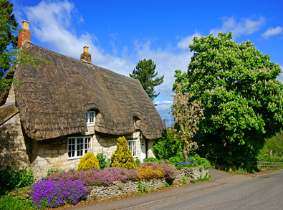
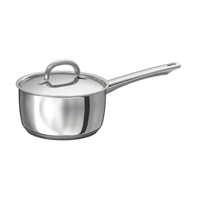
Vocabulary Check
Vocabulary: Using a dictionary, if needed, to check the meaning of words.
in a little cottage
enchanted wood
Saucepan Man

Slide 7
Quick Start
Retrieval: Finding the answers directly inside the text.
Who were the three main children? (R)
Who was coming to stay with the children? (R)
Why is he coming to stay? (R)

Slide 8

Individual Thinking
Infer: Thinking about what the text is telling us.
Explain: Using our ideas and own experiences to justify our answer.
'He was a happy boy, rather naughty, and it would be such fun to have him.’
Why do you think they thought it would be fun for Rick to stay with them? (I, E)

Slide 9
Individual Thinking
The three children flew upstairs
What does the word ‘flew’ tell us here? (V)

Slide 10

Partnered Talk
Predict: Using evidence from the text, what do you think will happen/what could be going on?
‘Hey! What will Rick say when we tell him about the Enchanted Wood and the Faraway Tree?’ cried Joe. ‘And what will he say when we show him our friends there – Silky, and old Moon-Face, and the dear old deaf Saucepan Man, and everyone!’ said Beth.’
What could these things be? (P)

Slide 11

Partner Work
Summarise: Precis (shorten) what you have read in a certain number of words.
Summarise what we have read in fewer than 20 words.
What is the gist of the chapter so far? (S)

Slide 12
Time to…..
Continue to read from page 4

